Slide 1


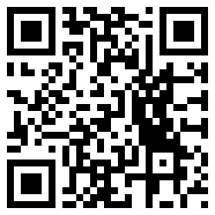
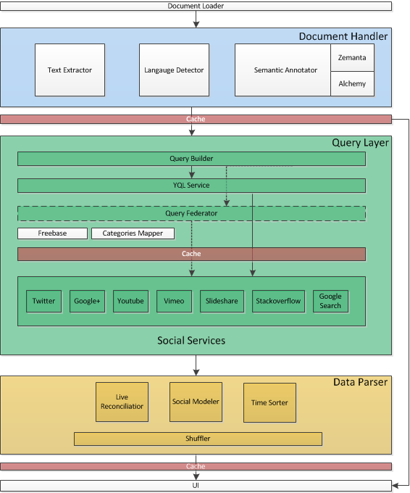

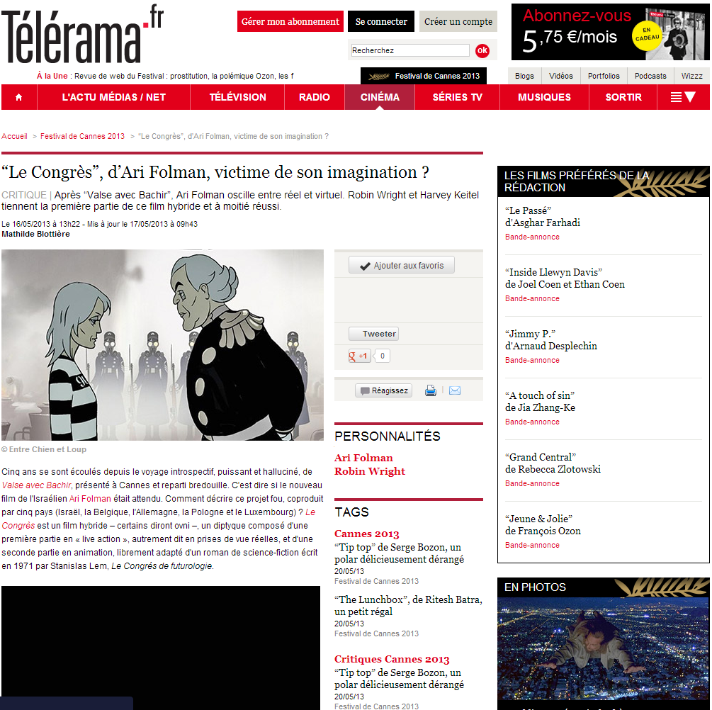
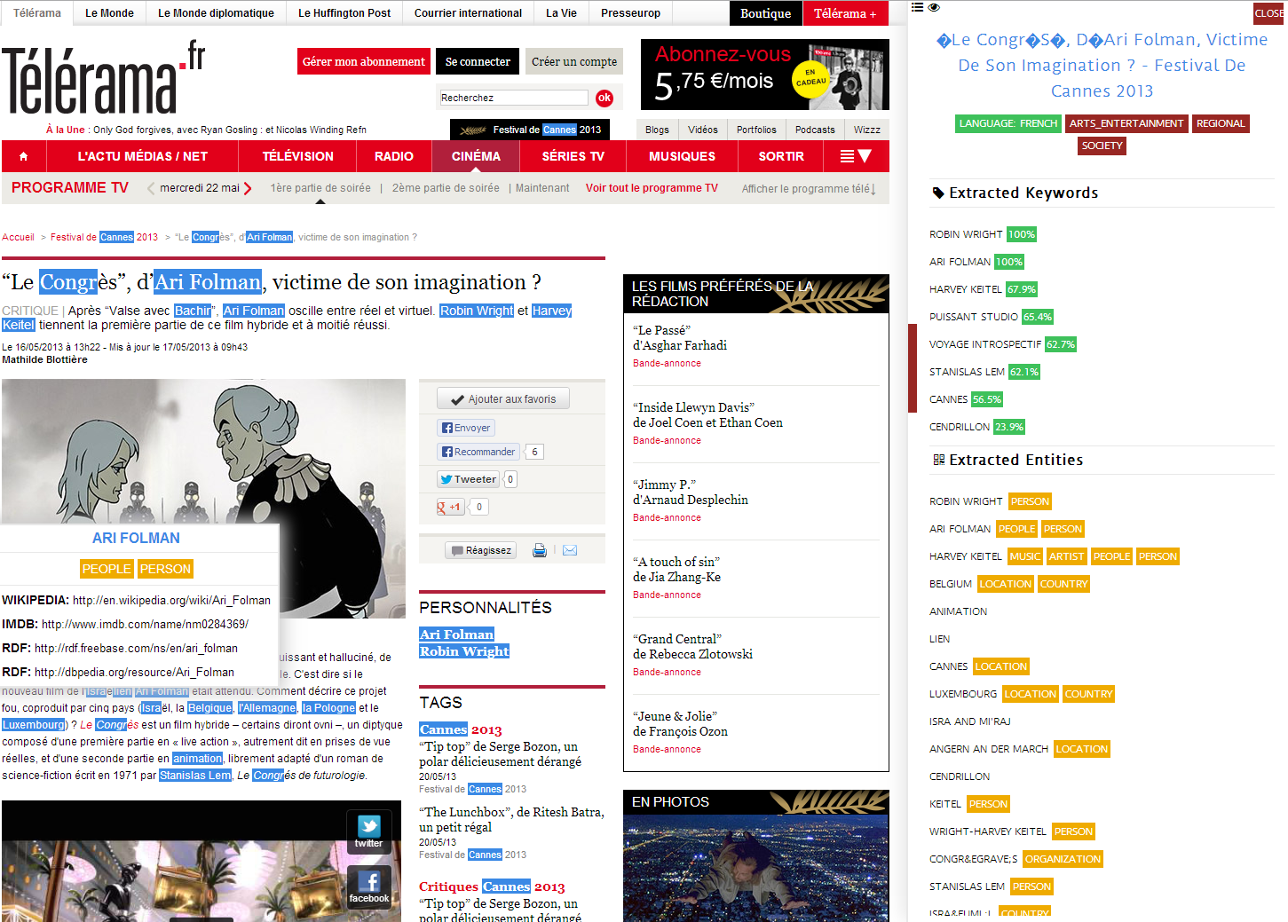
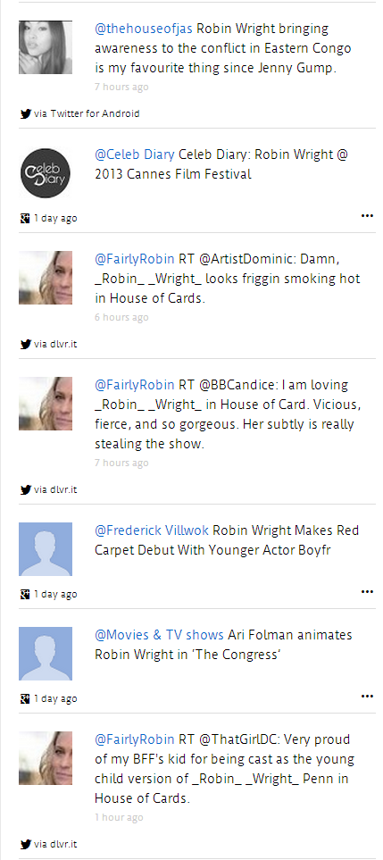


SNARC(1) : A Semantic Social News Aggregator and Recommender
‡EURECOM
2229 route des crètes, 06560 Sophia Antipolis, France
raphael.troncy@eurecom.fr
Ahmad Assaf† , Aline Senart† and Raphaël Troncy‡
†SAP Research, SAP Labs France SAS
805 avenue du Dr. Maurice Donat, BP 1216, 06254 Mougins Cedex, France
first.last@sap.com
A service that semantically annotate web documents, query social endpoints and reconcile results in order to provide rich and up-to-date contextual information
Given a Web document URL, SNARC will perform the following steps:
1
Document Handler: leveraging services like Alchemy (2) and Zemanta (3) this component creates a “Semantic Document” model that contains a set of annotations (Keywords, Concepts, Categories and Entities) extracted from the textual content of the web resource. It also detects the resource’s language and main title information
2
Query Layer: this component is responsible for disseminating queries to the various social services supported. Depending on the categories of the Semantic Document we filter out the selection of the targeted social services. In addition to that, for querying YouTube API we perform a search on the Freebase ID that matches the current keyword as well as targeting specific categories retrieved by mapping the category result in the Semantic Document and those of YouTube.
3
Data Parser: this module combines the results retrieved from the various social APIs and unify them in a common social model. A reconciliation module annotates the retrieved result and performs matching techniques to ensure that the results retrieved matches the Semantic Document categories and entities.
SNARC is a service that generates a JSON file. A Chrome Extension has been implemented as a possible UI usage of SNARC. An ongoing effort is to encapsulate it as a Wordpress Plugin as well
1
2
3
http://ahmadassaf.com/SNARC
http://www.alchemyapi.com
http://www.zemanta.com/

